Slide 1

SPINNAKER ANALYTICS
Fuel Efficiency Prediction and Analysis for Automotive Insights
Annamalai Kannan
Boston Institute of Analytics

Slide 2
Agenda
1
2
3
4
5
Objective
Primary Goals
Loading and analyzing the data set
Model Building
Summary

Slide 3

Objective
The aim is to leverage data-driven approaches to revolutionize the automotive sector. This project focuses on accurately predicting fuel efficiency based on various automotive attributes, enabling manufacturers to optimize designs and gain a competitive edge. The goal is to develop a predictive model that effectively analyzes automotive attributes to provide precise fuel efficiency predictions.

Slide 4

Primary goals

Slide 5
Deliverables
1
2
3
Predictive Model for Fuel Efficiency Prediction- Develop a robust predictive model utilizing machine learning algorithms to accurately forecast fuel efficiency based on automotive attributes.
Data Visualization: - Utilize interactive visualizations to illustrate the relationships between various automotive attributes and fuel efficiency.
Project Report: - Compile a comprehensive project report outlining the methodology employed in data collection, preprocessing, model development, and evaluation.

Slide 6

Loading and analyzing the data set

Slide 7
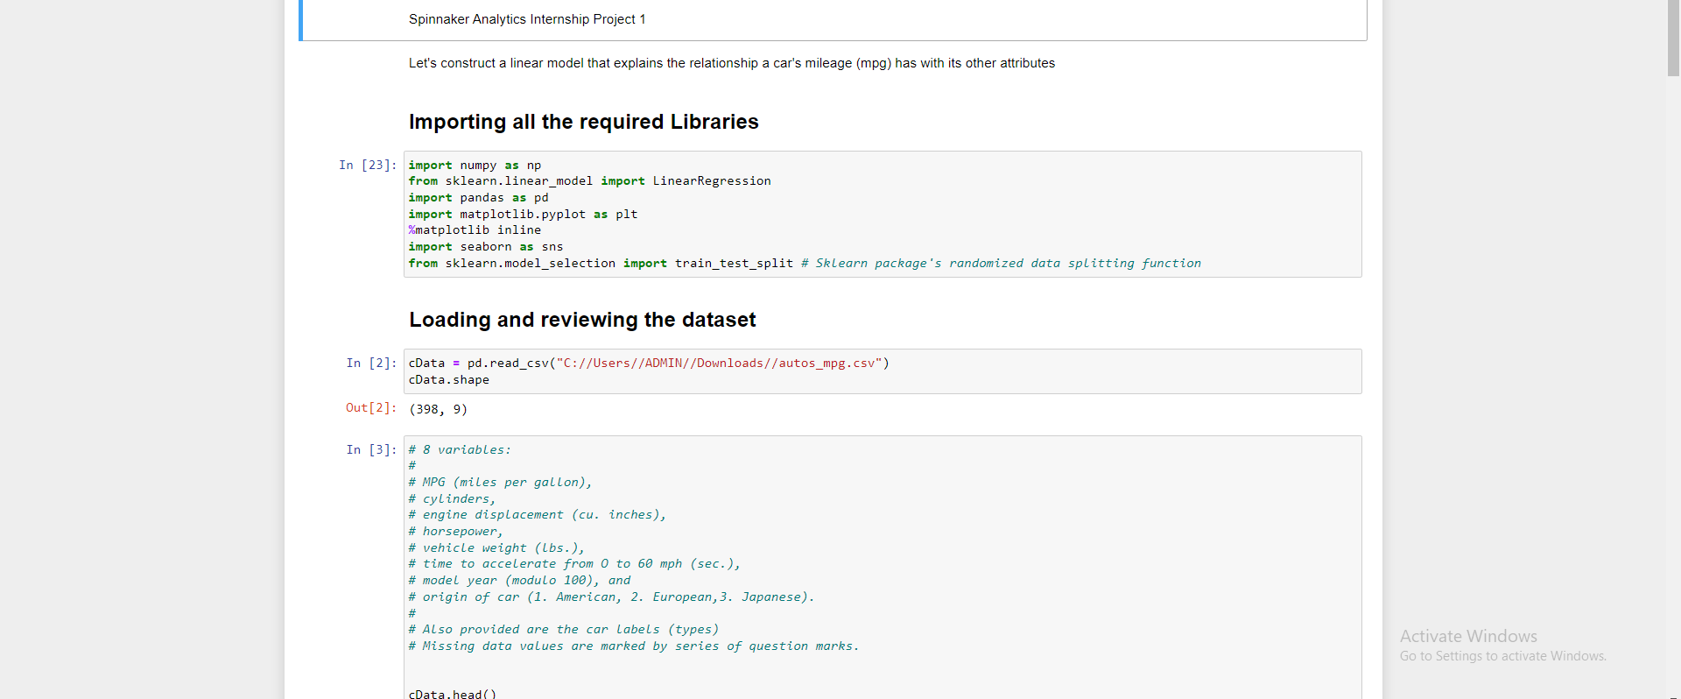
LOADING AND ANALYZING THE DATA SET

Slide 8
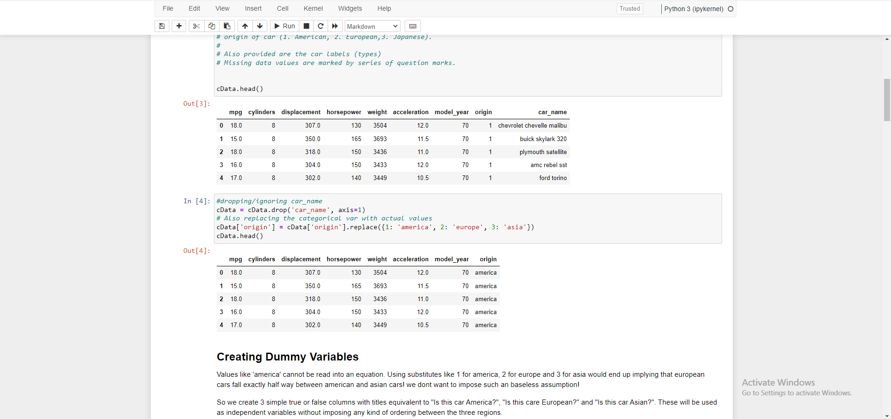
HEAD OF DATA SET

Slide 9
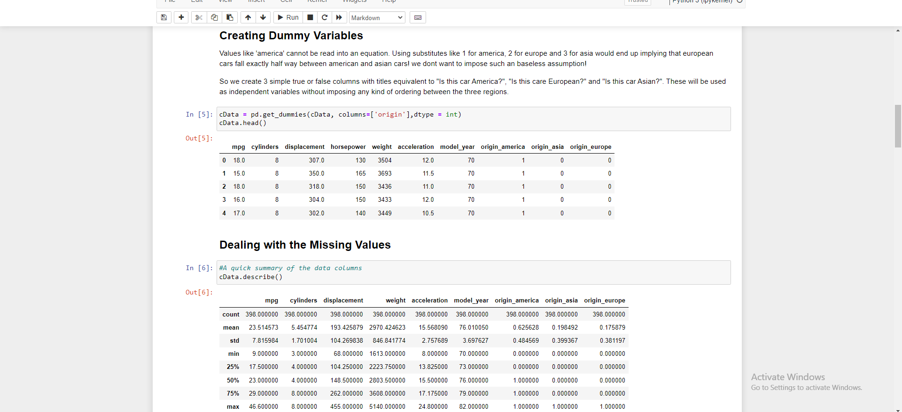
PRE-PROCESSING

Slide 10
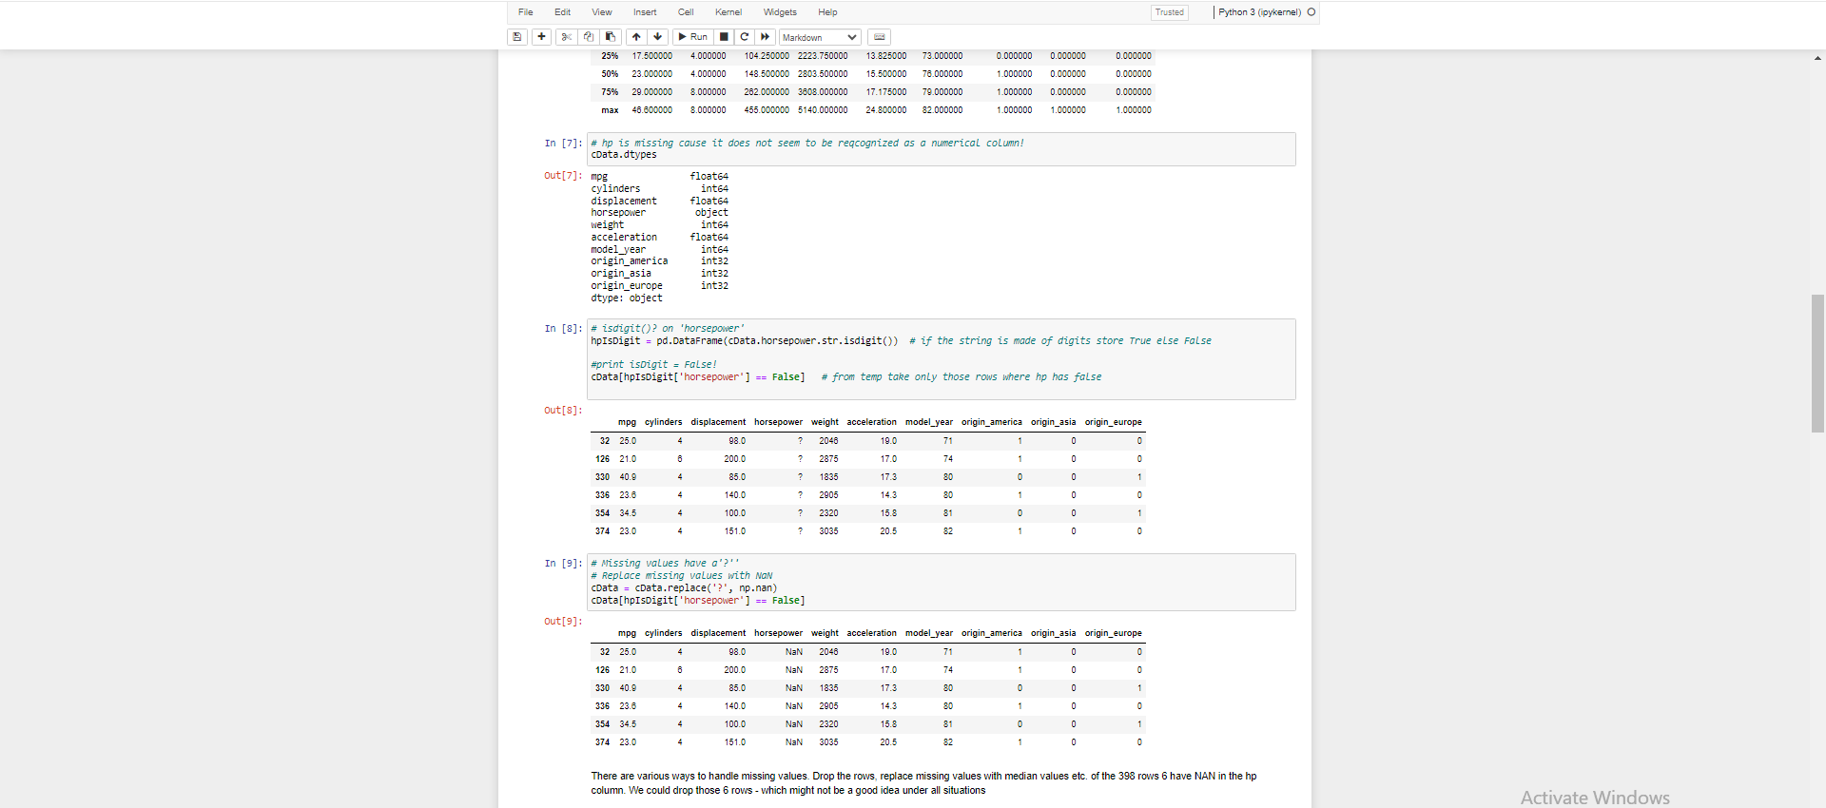

Slide 11
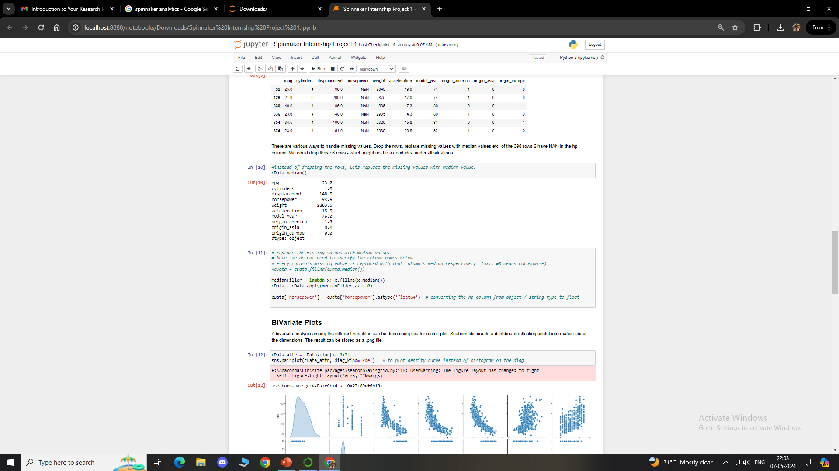

Slide 12
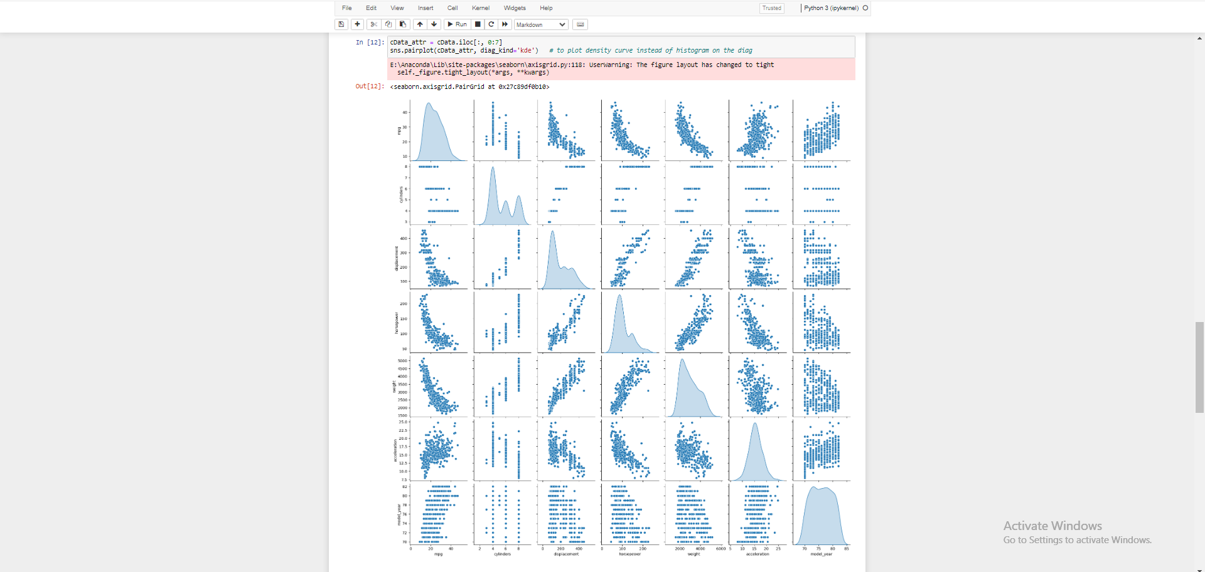
VISUALIZATION

Slide 13

Model Building

Slide 14
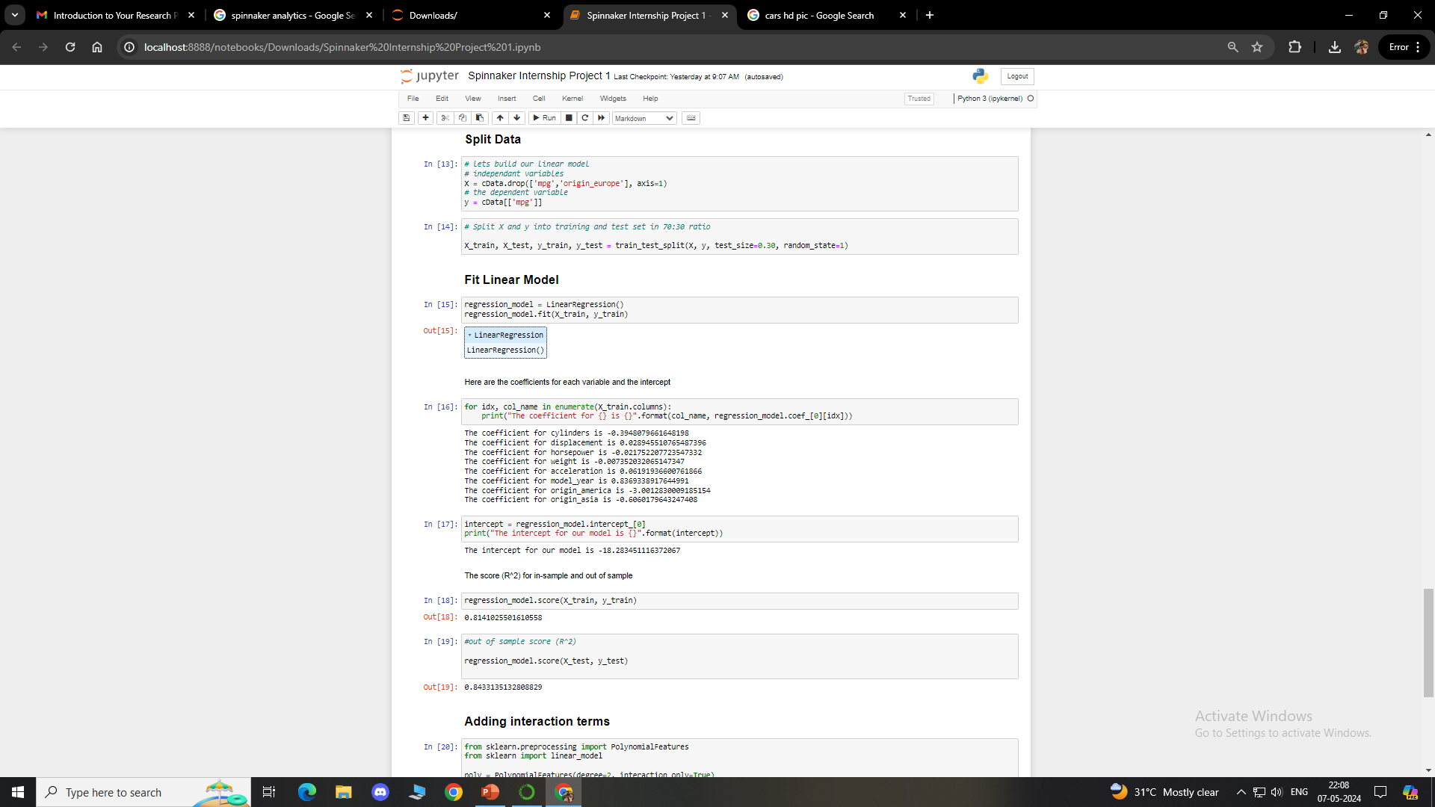

Slide 15
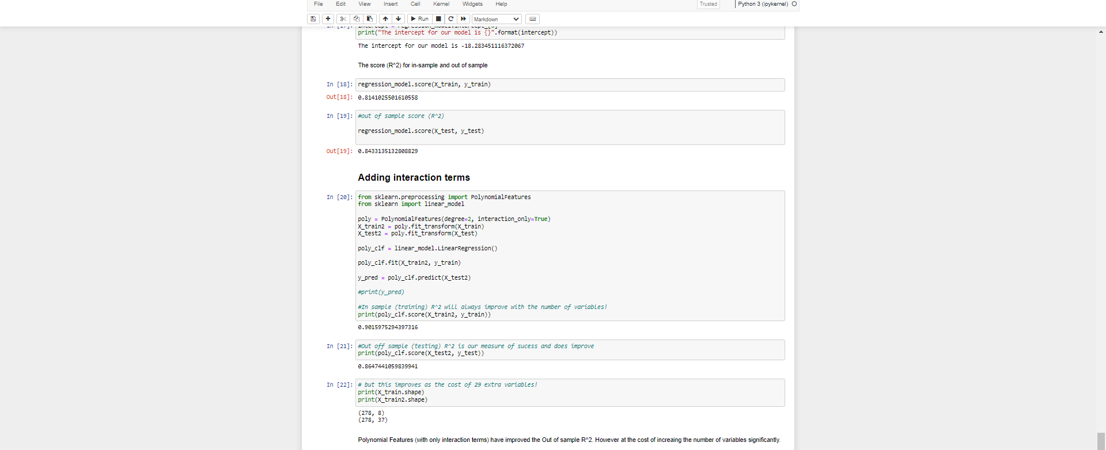

Slide 16

Summary

Slide 17
Observation between 'mpg' and other attributes indicate the relationship is not linear. However, the plots also indicate that linearity would still capture quite a bit of useful information/pattern. Several assumptions of classical linear regression seem to be violated, including the assumption of no Heteroscedasticity.
The coefficient for cylinders is -0.3948079661648198
The coefficient for displacement is 0.028945510765487396
The coefficient for horsepower is -0.021752207723547332
The coefficient for weight is -0.007352032065147347
The coefficient for acceleration is 0.06191936600761866
The coefficient for model_year is 0.8369338917644991
The coefficient for origin_america is -3.0012830009185154
The coefficient for origin_asia is -0.6060179643247408
The intercept for our model is -18.283451116372067
The score (R^2) for in-sample and out of sample
Polynomial Features (with only interaction terms) have improved the Out of sample R^2. However, at the cost of increasing the number of variables significantly.

Slide 18

Thank you
Annamalai Kannan
annamalaikannan47gmail.com
+91 8056246365

